Slide 1
OFDM Simulation
方宣翔

Slide 2
Handwriting report

Slide 3
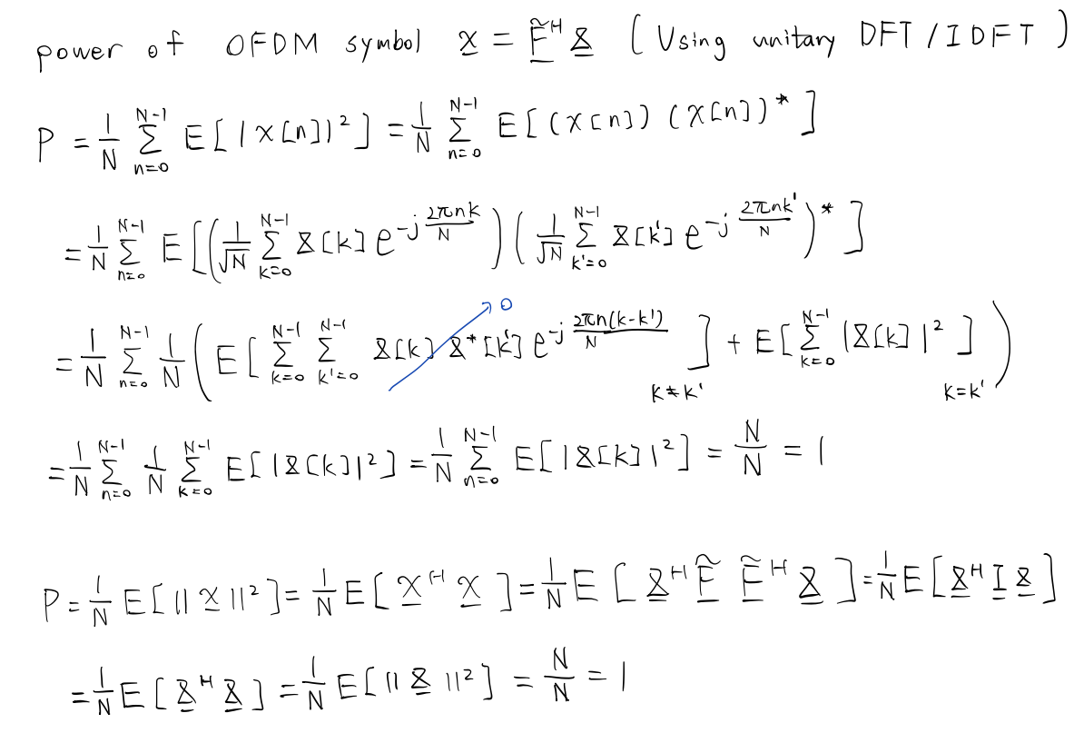

Slide 4
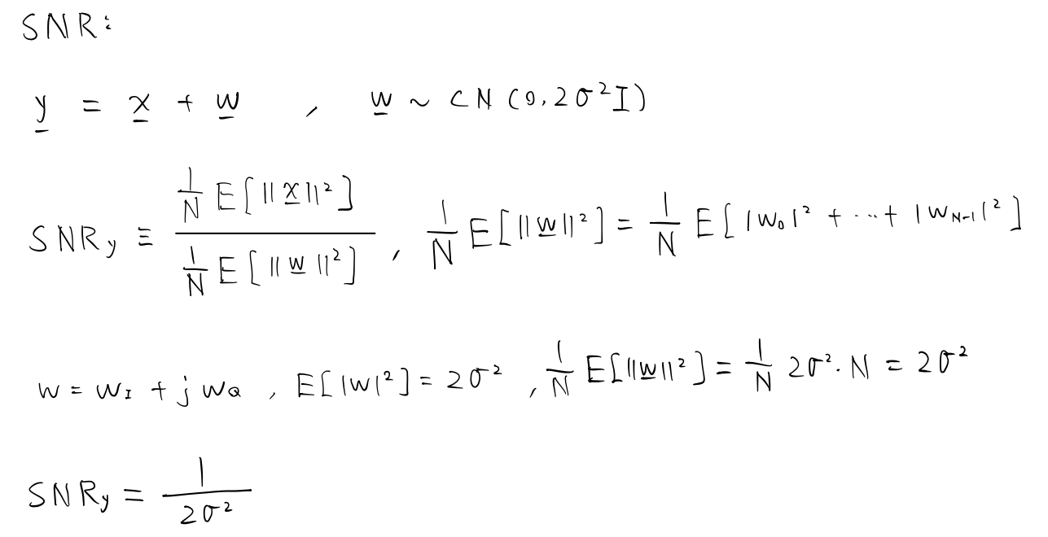

Slide 5
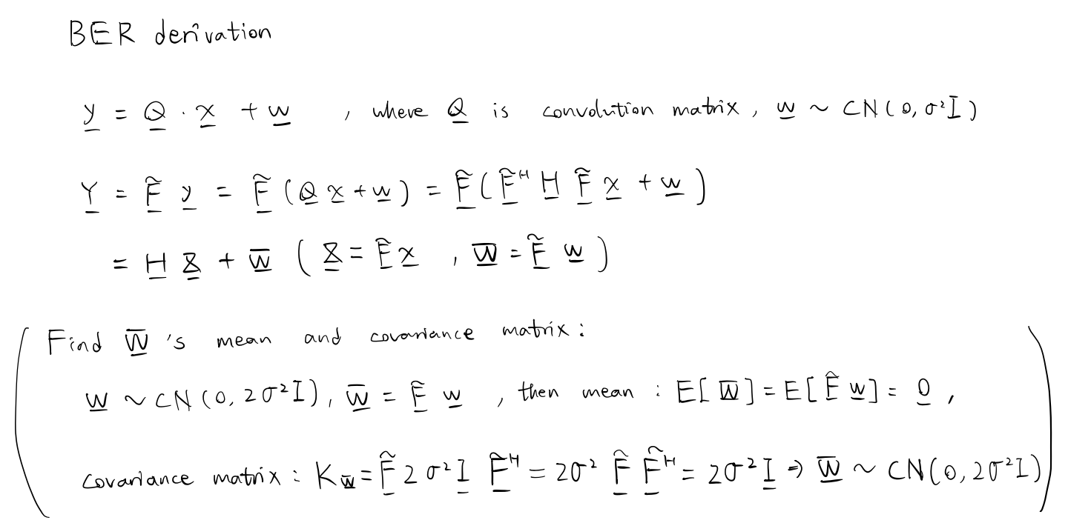

Slide 6
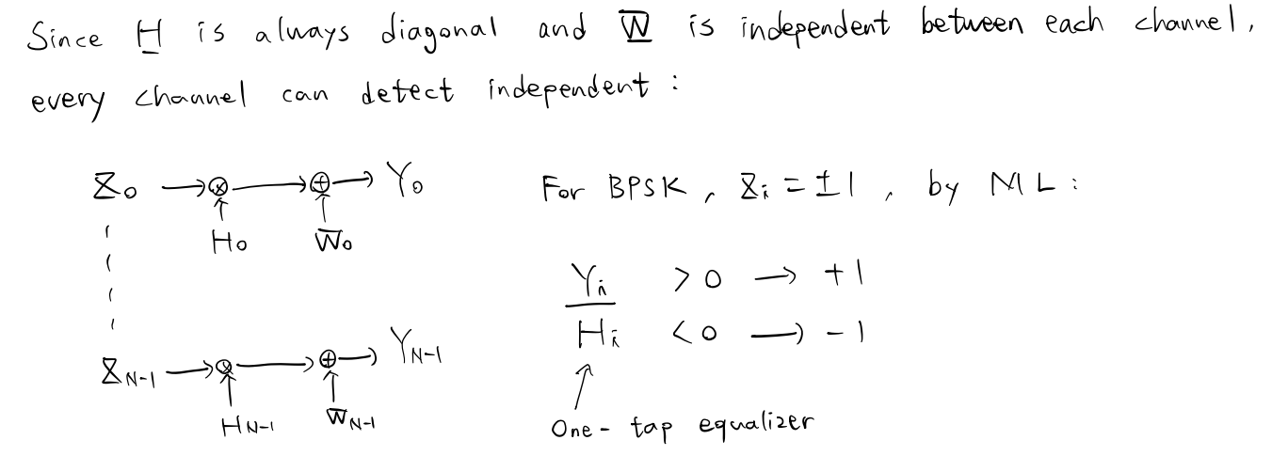

Slide 7
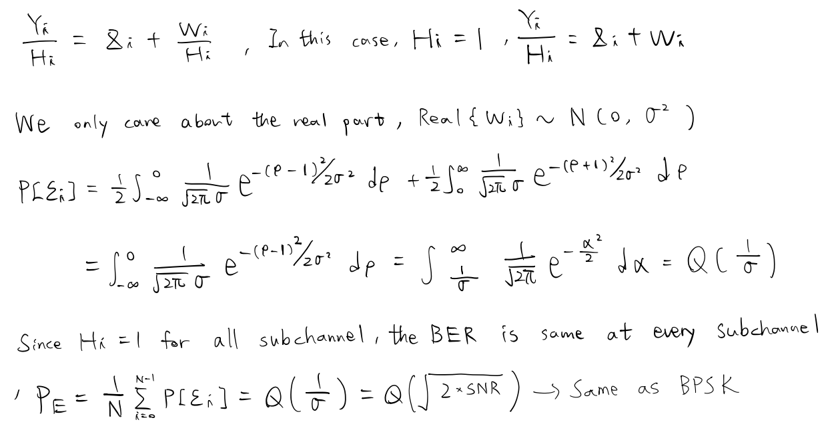

Slide 8
Simulation result

Slide 9
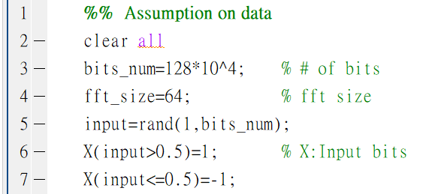
Assumption on OFDM system
Number of bits: 128*10^4.
Bits: +-1.
FFT size: 64 or 128.
Matlab code:

Slide 10
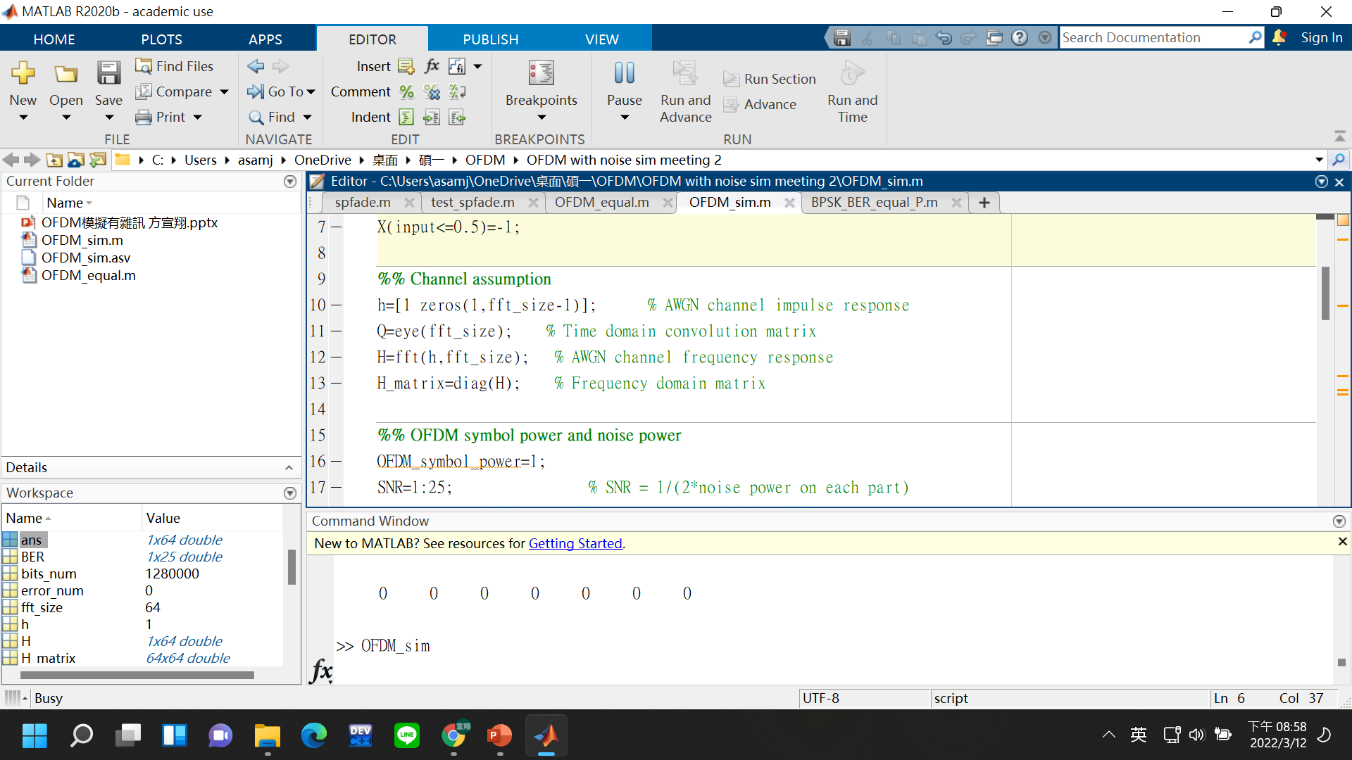
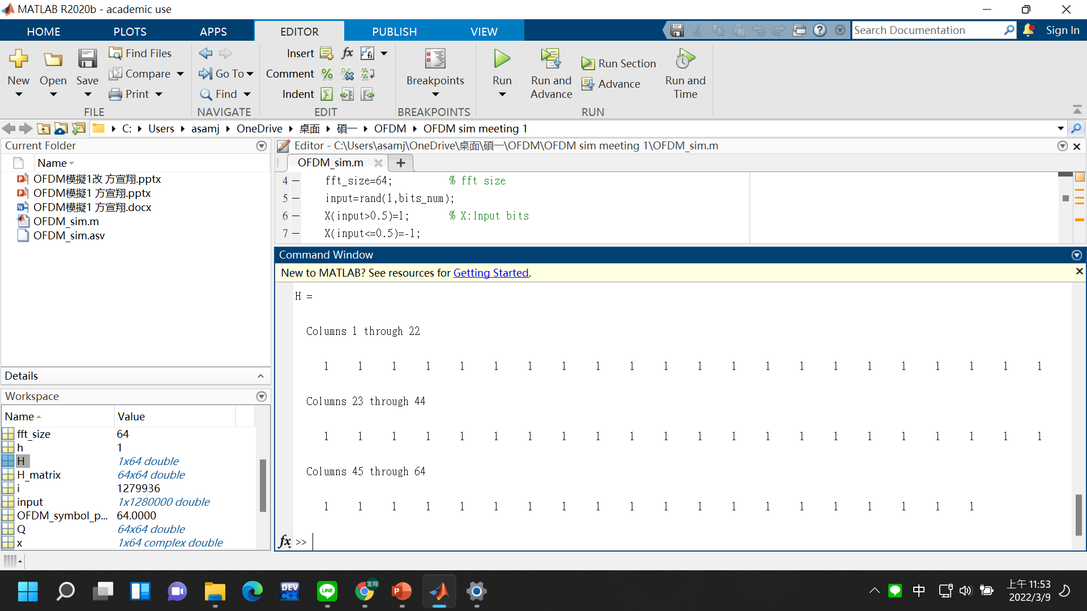
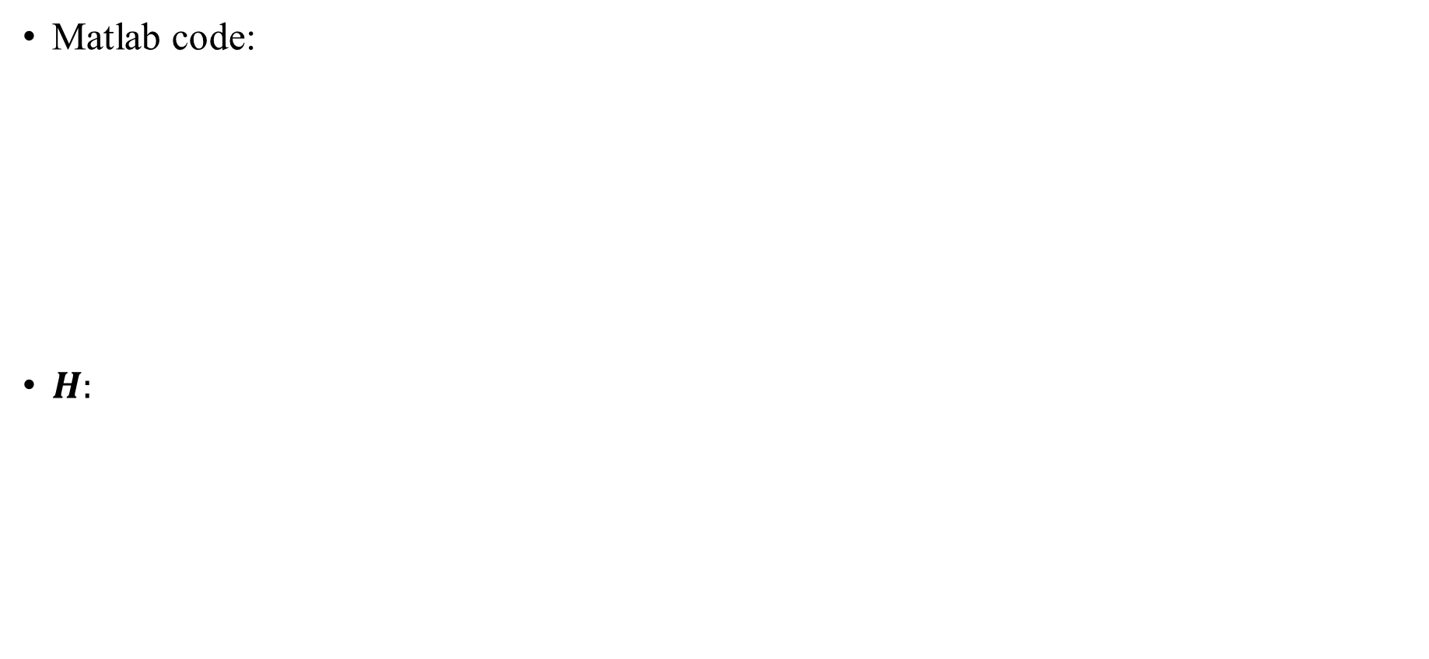
AWGN channel
Matlab code:
$H:$

Slide 11
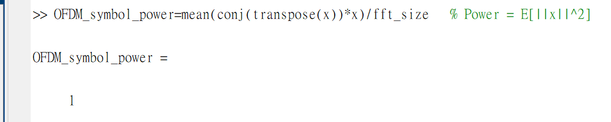
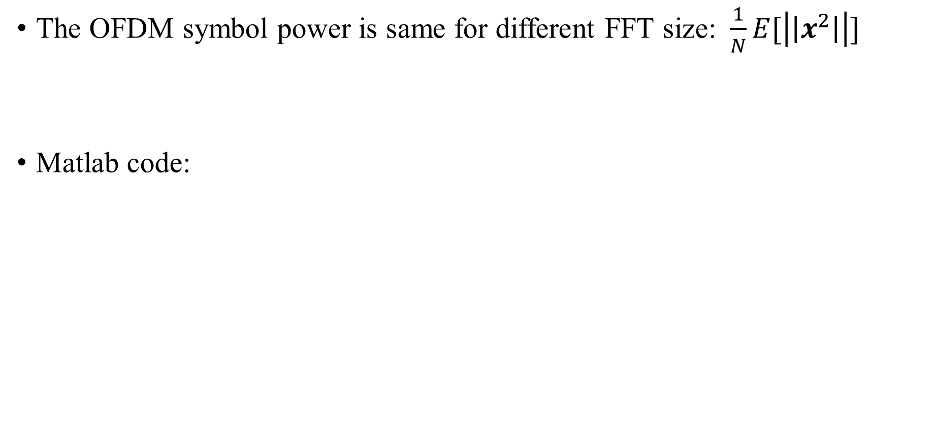
OFDM symbol power
The OFDM symbol power is same for different FFT size: $\frac{1}{N}E[\left|\left|x^{2}\right|\right|]$
Matlab code:

Slide 12
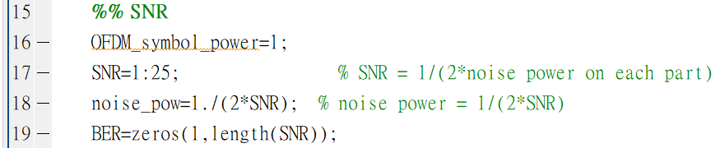
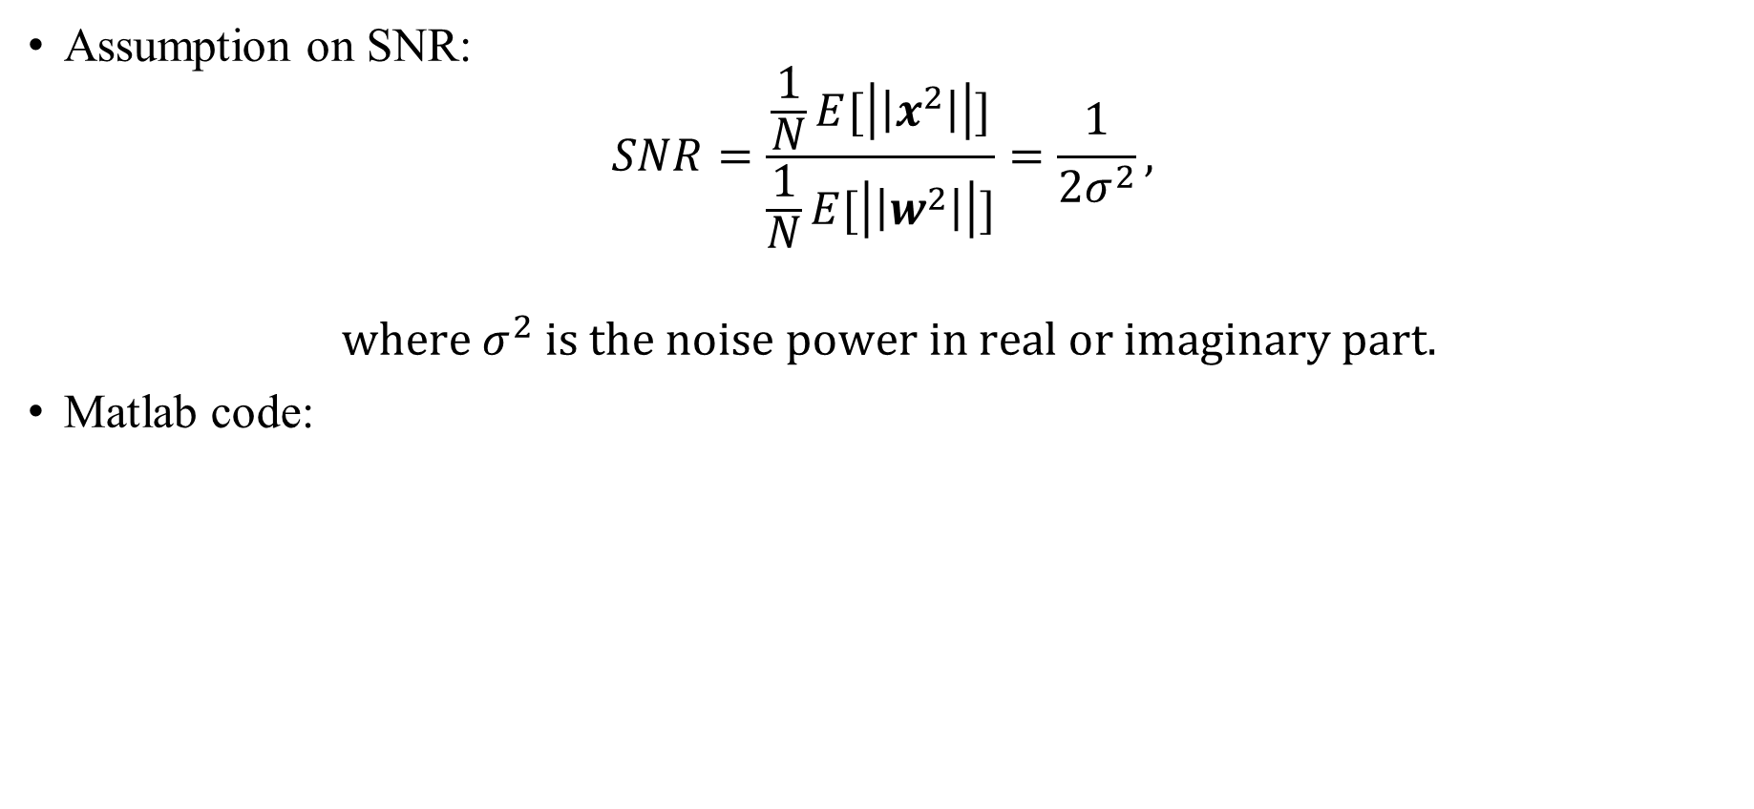
SNR
Assumption on SNR:
$$SNR=\frac{\frac{1}{N}E[\left|\left|x^{2}\right|\right|]}{\frac{1}{N}E[\left|\left|w^{2}\right|\right|]}=\frac{1}{{2σ}^{2}},$$
$$where σ^{2} is the noise power in real or imaginary part.$$
Matlab code:

Slide 13
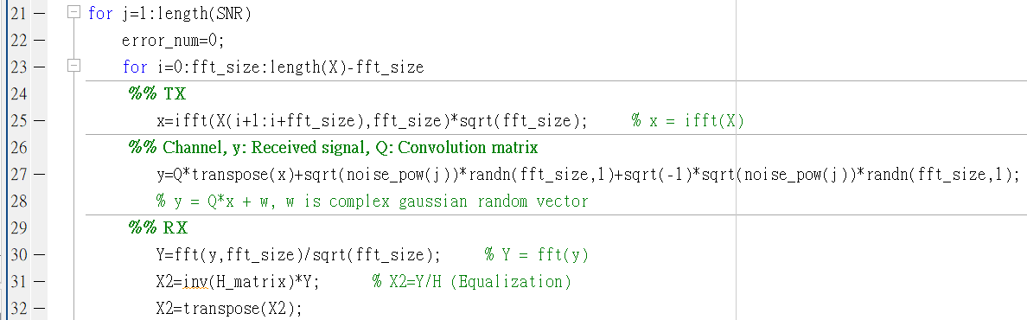
Modulation and demodulation

Slide 14
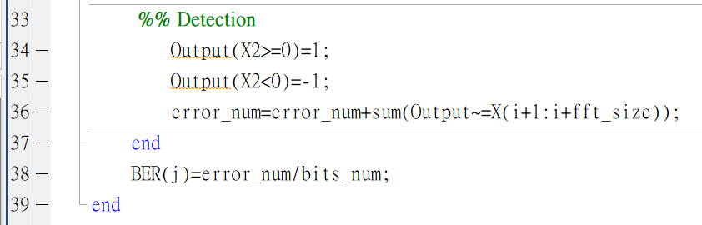
Detection

Slide 15
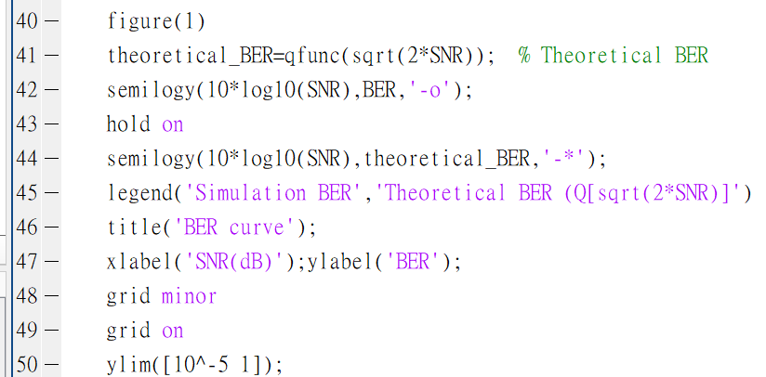
BER curve

